Slide 1

Notes:
Selim

Slide 2

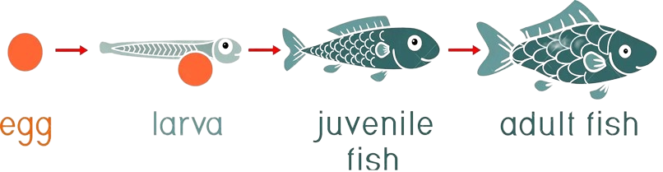
01 – the issue
Inaccurate Fish Count is Sinking Hatcheries’ Profits
Inaccurate Counting
Only 20% of larvae make it to the next stage,
heavily hammering production
Overestimation
Underestimation
Oxygen Surplus
Food
Surplus
Food
Shortage
Oxygen Shortage
Respiratory Diseases
Toxic Environment
Malnutrition
Respiratory Disease
High Mortality Rate
Low Quality Product

Slide 3
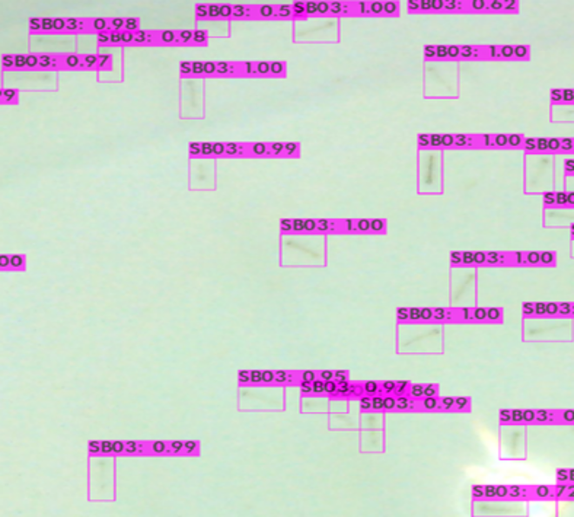
02 – THE SOLUTION
Aquadeep Has Developed the First Larva Counter on The Market
Oxygen 1
Plug & Play AI based fully exhaustive fish larva counter
95%
Accuracy Rate
Up to 25%
Increase in Survival Rate
2
Patents
(National and International)

Slide 4
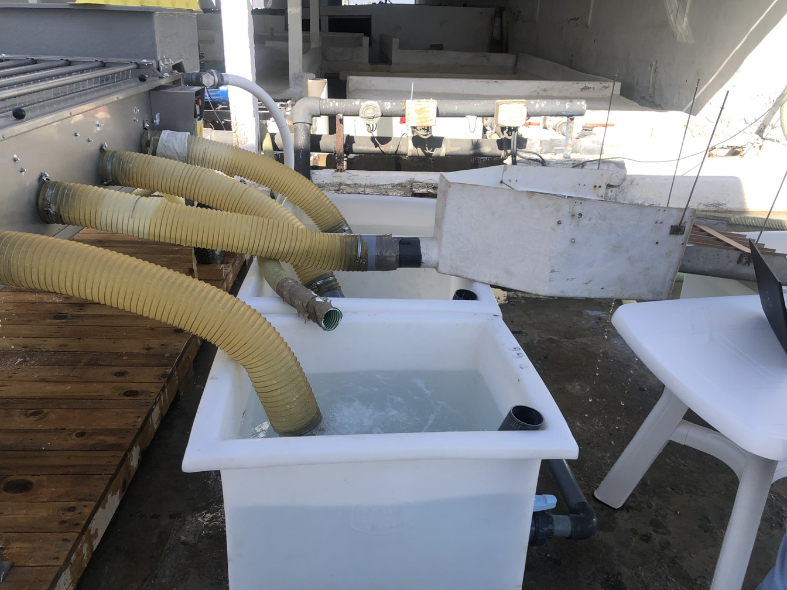
03 – THE SOLUTION
Aquadeep Has Also Developed the First Fully AI Empowered Juvenile Counter
Oxygen 2
State of the Art Computer Vision Based Juvenile Counter
95%
Accuracy Rate
600k
Fish/Hour Counting Capacity
2
Species Covered

Slide 5
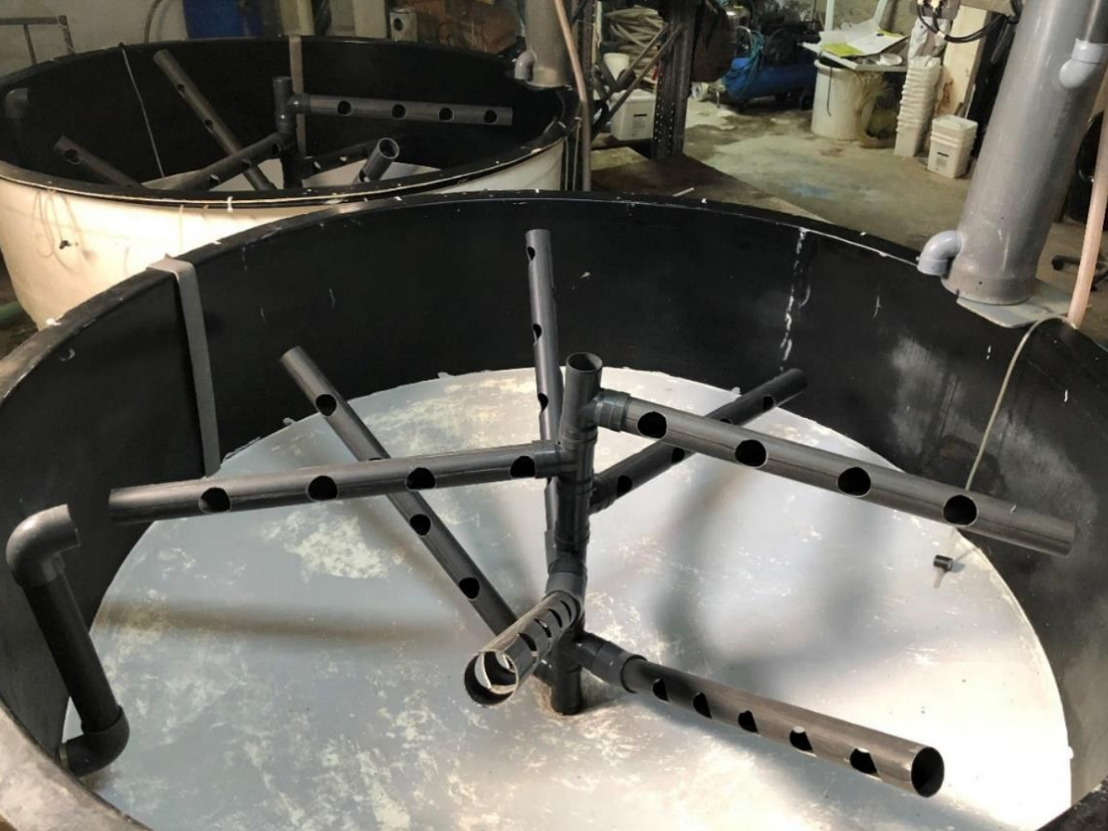
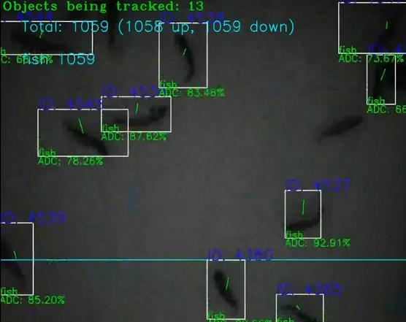
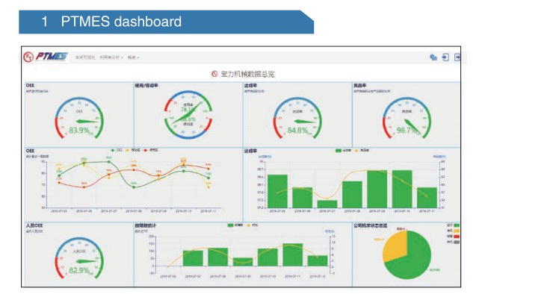
04 – THE Business model
The Business Model: B2B
Larva Counter
Juvenile counter
MES
6 000€
18 000€
(on quote)
1000€ annual subscription fee
8 counts/day
online plateform
15% on second purchased counter
450€ production costs
600k fish per hour
automatic report generation
15% on the second purchased counter
4650€ production costs
Annual subscription fee for cloud services
Monitoring vital parameters using IoT.
Alert and visualization platform with a latency time of less than 7 seconds.

Slide 6








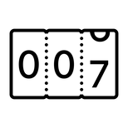




05 – THE COMPETITION
The Only Producer of Both Juvenile and Larva Counting Solutions
FAIVRE
VAKI
XpertSEA
AQUADEEP
Larva counter




counting capacity larva counter
N/A
N/A
1500 units
2000 units
Larva Counter Pricing
N/A
N/A
7500€
6000€
Juvenile counter




counting capacity juvenile
counter
Comptage poisson 1g+
300K/h
500K/h
N/A
500K/h
Juvenile counter pricing
25 000€
45 000€
N/A
18 000€

Slide 7

06 – THE market
The Global Aquaculture Market
Europe
300 B$
13B $
America
Mediterranean
22B $
14B $
MENA
13B $
Africa
75 B$
11B $
17.3 B$
Notes:
Google sheet source: https://docs.google.com/spreadsheets/d/1scKtD6a9zPhbpj_YxcdHbOwQO2qVVU5R/edit?usp=drive_link&ouid=112151810071096995806&rtpof=true&sd=true

Slide 8

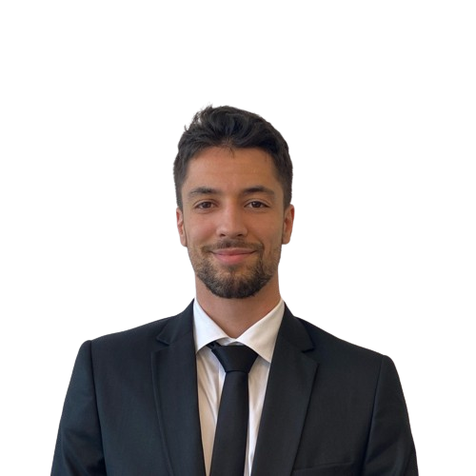
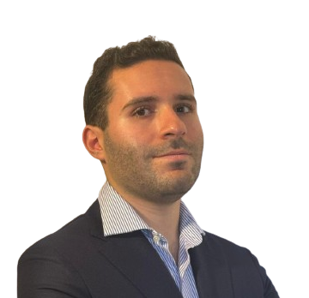












07 – THE Team
The Team: Building the future of sustainable aquaculture
Mohamed Ben Ahmed
CEO
Mohamed-Ali Chaambi
COO
Mohamed Ben Ahmed
CFO
Vision and strategy
Tech team lead
Sales
Customer prospection
Financial planning
Financial reporting
Company representative
Growth and development
Customer relations
Client contact
Risk management
Strategy
Business performance
Public face
Marketing
Social media
Investor relations
Financial control

Slide 9









08 – partners
Our Partners: the Key To our success

Slide 10

09 – funding
Funding So Far: Activation of program HALO By Smart Capital
150K Dinars
HALO is a global initiative aimed at catalyzing angel investment in the startup ecosystem in Tunisia by equipping Business Angels with the skills and support they need to spot investment opportunities and close deals with success.
HALO is a project implemented by Smart Capital in partnership with SPARK, and financed by the European Union, as part of the “From innovation to creation” program.
We secured 130K Dinars of funding that will serve to button up the products in development, Nevertheless, our required funding goal is still to be achieved...

Slide 11
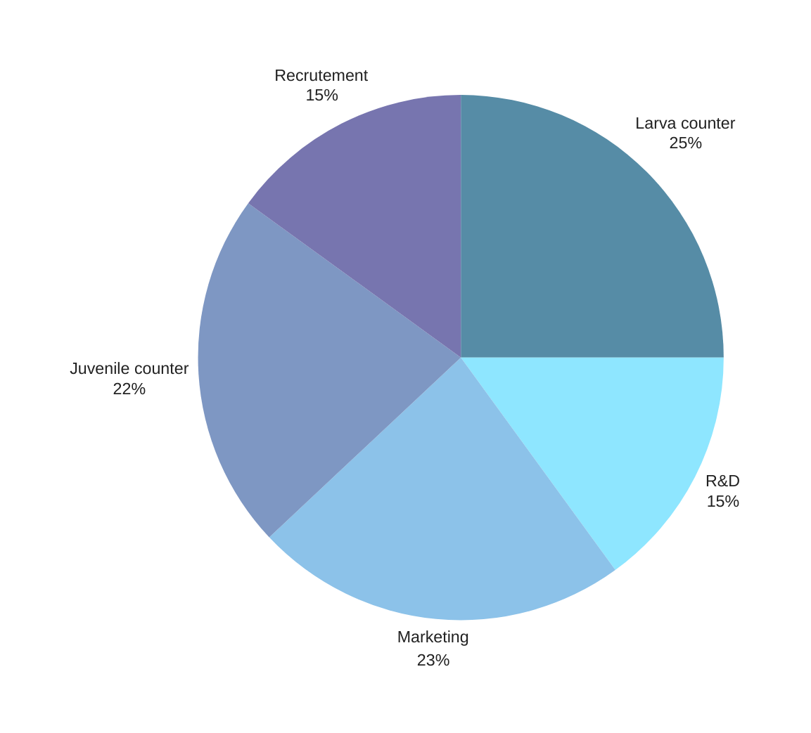

10 – funding
Funding Perspectives: A Step For The Future
350K€

Slide 12





11 – scalability
Horizontal Scalability: The Path To Business Growth
Counter for Artemia and Rotifer
Calibrate counter for a more global use
1
2
3
4
5
centralize decision making
Counter for fertilized eggs
Early detection of diseases and epidemics in the basin

Slide 13
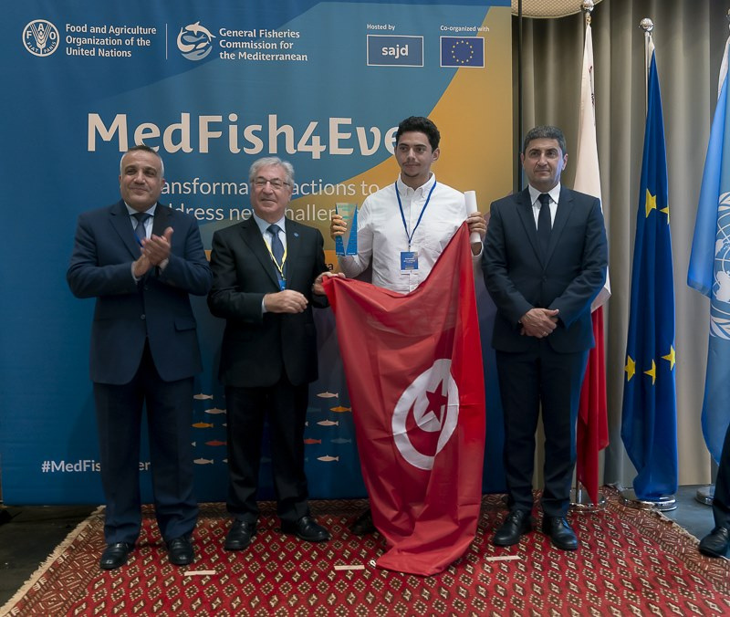

International Prize
Winner
Of the category: Innovative practices in aquaculture research for the development of a unique larva counting system for the industry.

Slide 14
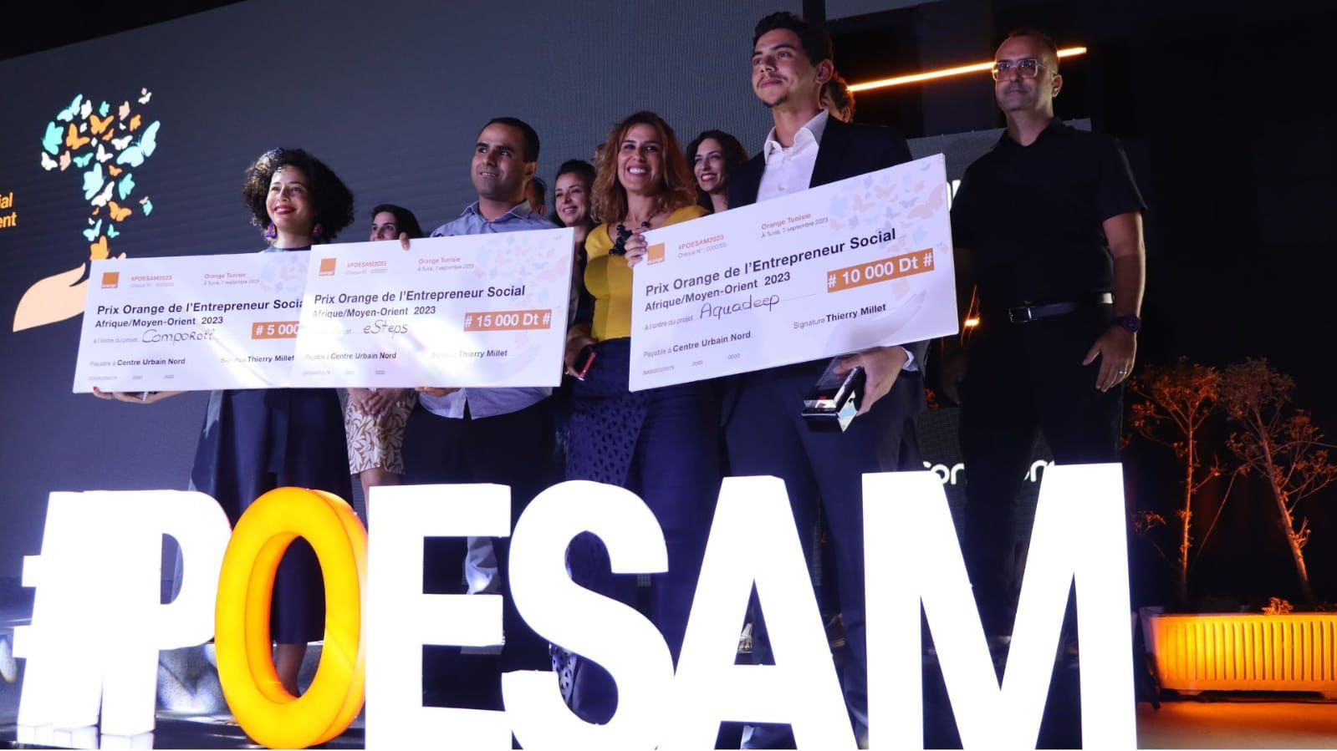
National Prize
2nd
Place at the Orange Prize for Social Entrepreneur in Africa and the Middle East, Tunis.

Slide 15

A Step Towards Internationalization
3rd
Selected alongside 22 Tunisian startups for Lab Innova 2024 for Tunisia, a step towards our extension into the Italian and European Markets.

Slide 16


info@aquadeep.com.tn
Contacts
www.aquadeep.com.tn
+216 92 606 334
1053 Lac Malären, Tunis

